Slide 1
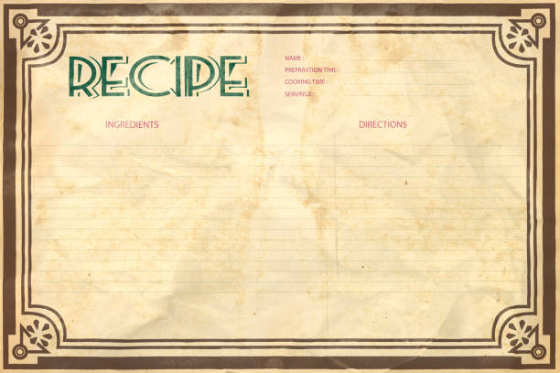
Recipe Search App

Slide 2
Summary
Have you ever wanted to find a new recipe and didn’t know where to start? What if you could enter an ingredient and get suggestions? This app will allow you to enter an ingredient and get ideas as well as nutritional facts for each ingredient as well as the full recipe.

Slide 3
Concept
This is a website that allows users to enter a type of food and get multiple recipes back.
AS a home cook, I WANT to find recipes, SO THAT I can try new dishes.
GIVEN I cook at home, WHEN I search an ingredient, THEN I get recipes

Slide 4
Process
Semantic UI, Edamam recipe search API and Nutrional Search API, Jquery, JavaScript, HTML, CSS.
Homepage – Sandeep, Recipe Page – Cheri, Modals - Chad
Trying to connect the two pages, API usage, GITHUB issues.
Getting the APIs to function correctly, correcting the GITHUB issues and making the two pages work together.

Slide 5
Demo

Slide 6
Directions for Future Development
Add option for random search
Add page implementation to search results
Creating a favorite list

Slide 7
Links
Deployed
GitHub repo

